Slide 1
PEIMS Update for DP Coordinators and IB Administrators November 3, 2023

Slide 2
10 Guiding Questions:
What are PEIMS numbers?
Who usually deals with PEIMS numbers?
Why are PEIMS numbers important?
What PEIMS numbers are used for IB Diploma Programme (DP) courses?
Why is there only 1 PEIMS number for DP courses lasting 2 years?
What about co-seated classes?
How is DP Computer Science credited on the student’s graduation plan?
Why is Theory of Knowledge (TOK) an innovative course?
Does TOK need special approval by the local school board?
How does a DP Coordinator or administrator make sure PEIMS
numbers are correct?
11. What questions have not been answered?

Slide 3
1. What are PEIMS numbers?
Number assigned by the Texas Education Agency (TEA) for every course completed by a student in a Texas public school from early childhood through graduation.
The PEIMS numbers create the student’s individual academic record.
For high school students, the academic record becomes the student’s transcript.
Sometimes called “service-ID” number

Slide 4
2. Who usually deals with PEIMS numbers?
Administrator creating the master schedule.
Data clerk entering the master schedule.
Counselors entering student choices or making schedule changes.
Without direct DP experience, the wrong PEIMS numbers or confusion about TEA approval of IB courses often happens.
DP Coordinators need to understand PEIMS numbers to prevent issues for DP students.

Slide 5
3. Why are PEIMS numbers important?
DP students need accurate transcripts when applying to university or for scholarships.
IB schools need for TEA to have an accurate record of the number of students in IB courses.
Extra funding for CATE courses depends on the accuracy of the PEIMS numbers submitted by the school and district.

Slide 6
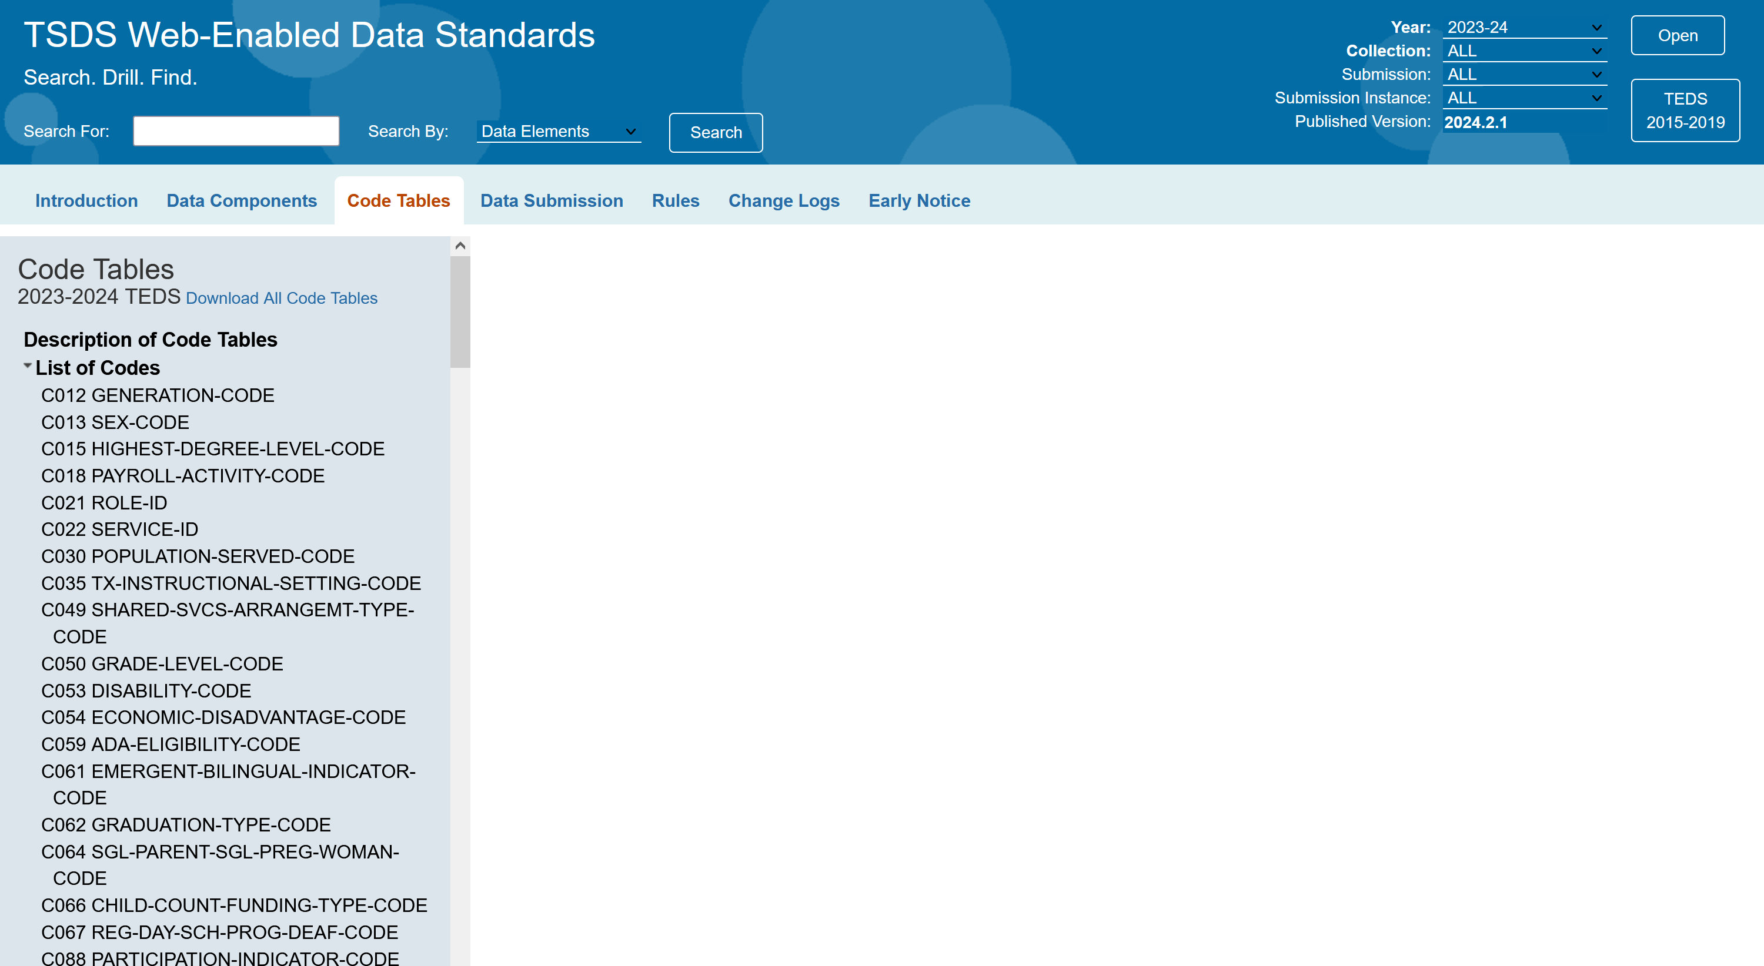
4. What PEIMS numbers are used for DP courses?
All PEIMS numbers are found in the annual C022 Data Table. https://tealprod.tea.state.tx.us/TWEDS/103/0/0/0/CodeTable

Slide 8
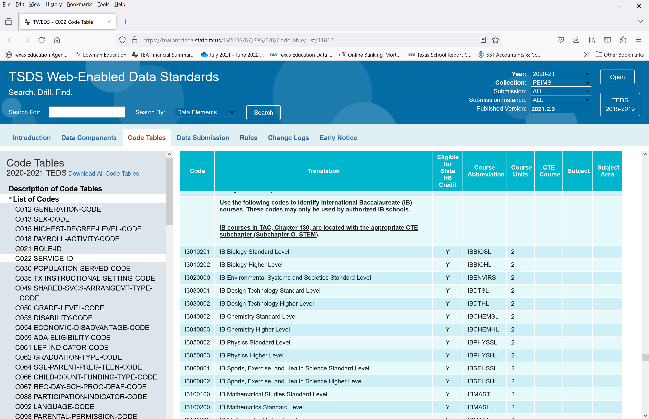
4. What PEIMS numbers are used for DP courses?
Open the C022 table and scroll to the IB section.
The sections can be highlighted, copied, and pasted into Excel or Word.

Slide 9
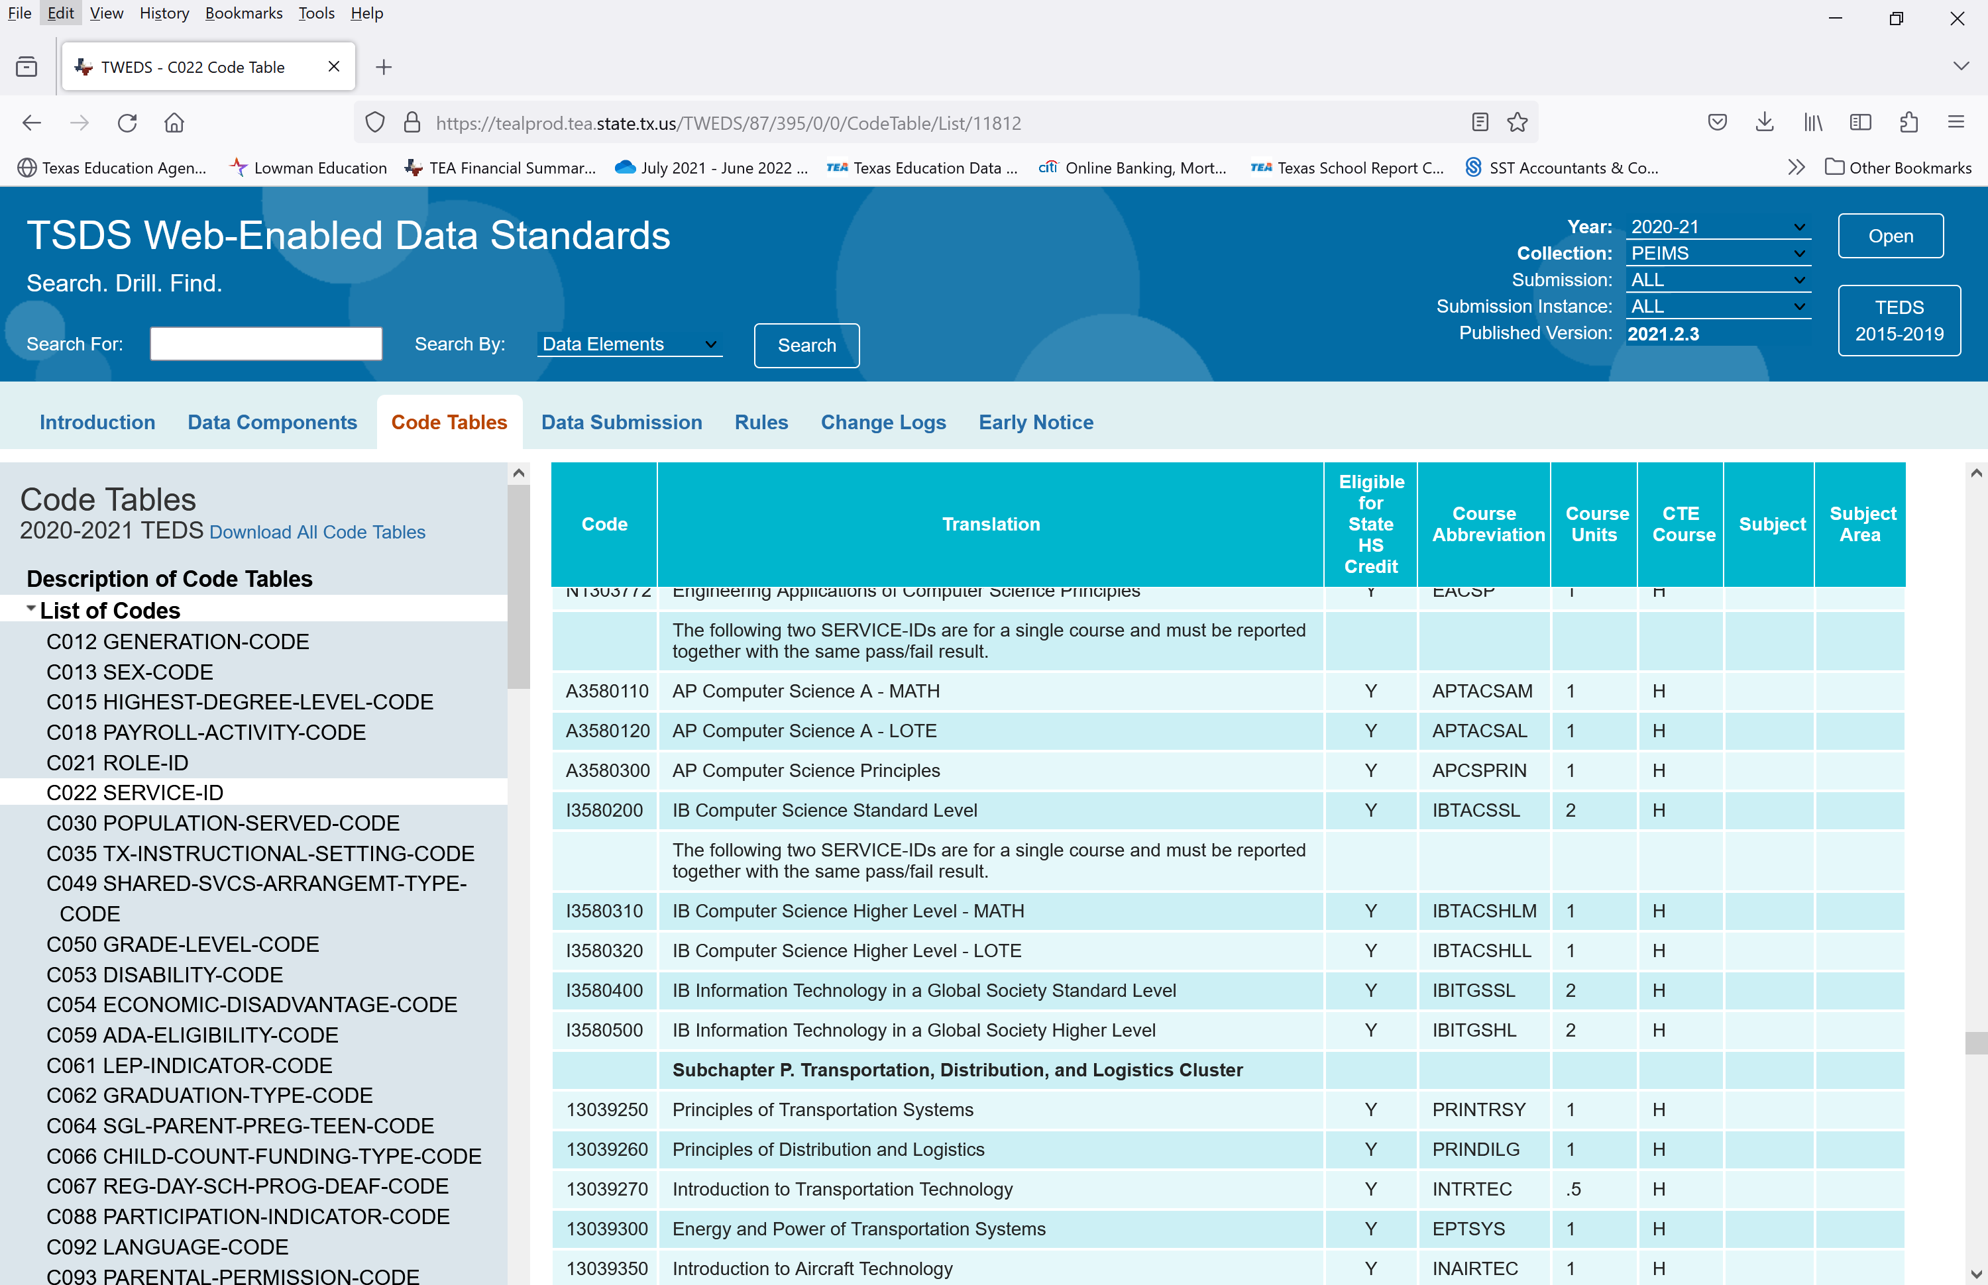
4. Where are the PEIMS numbers for IB Computer Science and Digital Society (formerly: Information Systems in a Global Society (ITGS))?
These courses are in Subchapter 0 with the CTE courses.
The ITGS number may be used for Digital Society. The name can be changed locally, but the name will revert to ITGS if transcripts are sent electronically.
This is the first year for Digital Society. TIBS will reach out to TEA to change the name.

Slide 10
5. Why is there only 1 PEIMS number for DP courses lasting 2 years?
This causes much confusion.
The data table shows the same number qualified for 2 “course units” (credits).
Therefore, the same number can be used for both year 1 and year 2.

Slide 11
6. What about co-seated classes.
DP student must complete the DP course to sit the IB exam.
The student’s transcript is a legal document and must reflect accurately the courses completed by the student.
This may make multiple class rolls necessary.
DP coordinators need to check to make sure the
DP students are shown in a DP class.

Slide 12
7. How does TEA direct DP computer science to be credited on a student’s graduation plan?
Computer Science Higher Level and Standard Level quality for CATE weighted funding.
Computer Science Higher Level Notes: By law, Computer Science courses may now be used to meet LOTE requirements.
This creates an interesting situation with Computer Science Higher Level. TEA guidance on how to award the credit is shown below. The credit for mathematics and LOTE are to be awarded by semester with the student receiving .5 Math and .5 LOTE in each of the two years according to TEA further guidance.
The IB Computer Science HL course may only be used as one math credit and one LOTE credit and the PEIMS service IDs are structured accordingly. A student would need a second course from the list of computer programming languages approved to satisfy the LOTE requirement to complete the second credit requirement for LOTE.
(k) A district shall allow a student who successfully completes AP Computer Science A or IB Computer Science Higher Level to satisfy both one advanced mathematics requirement and one languages other than English requirement for graduation.

Slide 13
7. How does TEA direct DP computer science to be credited on a student’s graduation plan?
Term | Course Number | Course Name | Credit | Graduation Requirement
Fall Junior | 13580310 | IB Computer Science – Math | 0.5 | Math
Spring Junior | 13580320 | IB Compute Science – LOTE | 0.5 | Languages other than English (LOTE)
Fall Senior | 13580310 | IB Computer Science – Math | 0.5 | Math
Spring Senior | 13580320 | IB Computer Science – LOTE | 0.5 | Languages other than English (LOTE)

Slide 14
8. Why is Theory of Knowledge (TOK) an innovative course?
TEA determined TOK does not link to specific Texas Essential Knowledge and Skills.
Therefore, TEA designated TOK with an innovative course number.
Because it has an innovative course number, TOK counts as an elective and cannot be used to fulfill a specific graduation requirement.

Slide 15
9. Do TOK and IB Business Management need special approval by the local school board?
TEA guidance states, “With the approval of the local board of trustees, school districts and open-enrollment charters may offer any state-approved innovative course for state elective credit only. Innovative courses may not meet any other specific graduation requirement. LEAs do not need to apply to TEA to offer an approved innovative course. Innovative courses are approved to meet certain endorsement requirements on the Foundation High School Program.” (source: https://tea.texas.gov/academics/learning-support-and-programs/innovative-courses#Implementation)

Slide 16
9. Do TOK and IB Business Management need special approval by the local school board?
Yes. If local school board policy and practice require individual approval of innovative courses.
No. If local school board policy and practice allow innovative courses to be approved as part of the annual approval of the high school course selection guide or list.

Slide 17
10. How does a DP Coordinator or administrator make sure PEIMS numbers are correct?
Understand the complexities around IB PEIMS numbers.
Know where to find the annually updated list of PEIMS numbers.
Make sure IB PEIMS numbers are used for IB classes
Be diligent so DP transcripts are correct.
Be diligent so TEA numbers for IB students
are correct.

Slide 18
11. What questions have not been answered?

